Slide 1
DATA SCIENCE Project
Dsquares Internship
Zomato Data Analysis & Prediction

Slide 2
CONTENTS OF THIS Project
Here’s what you’ll find in Slides:
First we will Discuss about Idea of the Project
Interpret the answers to our business questions.
Interpret the evaluation of our machine learning model.
Final summary for our results and how you can make use of it in this use case.

Slide 3
TABLE OF CONTENTS
01
02
03
OUR PROCESS
TARGET
PROBLEM & SOLUTION
We will build a classification model and use 5 algorithms to perform solutions
We have data for restaurants want to classify if it will still open or will close
Is to predict if the restaurant will close or no

Slide 4

Context
Restaurants from all over the world can be found here in Bengaluru. From the United States to
Japan, Russia to Antarctica, you get all types of cuisines here. Delivery, Dine-out, Pubs, Bars, Drinks,
Buffet, Desserts, you name it and Bengaluru has it.
Bengaluru is the best place for foodies. The number of restaurants is increasing day by day.
Currently it stands at approximately 12,000 restaurants. With such a high number of restaurants. This
industry hasn't been saturated yet. And new restaurants are opening every day.
However, it has become difficult for them to compete with already established restaurants. The
key issues that continue to pose a challenge to them include high real estate costs, rising food costs,
shortage of quality manpower, fragmented supply chain and over-licensing.
This Zomato data aims at analyzing the demography of the location. Most importantly it will help
new restaurants in deciding their theme, menus, cuisine, cost etc. for a particular location. It also aims at
finding similarity between neighborhoods of Bengaluru based on food. The dataset also contains reviews
for each of the restaurants which will help in finding overall rating for the place.

Slide 5
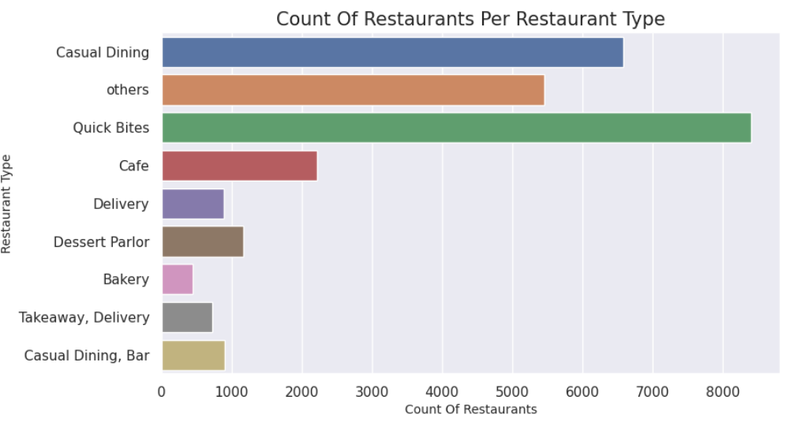
Interpret the answers to business questions.
1. What type of restaurants are most common in Bengaluru?
It’s a Bar Plot using Seaborn to show the count of each restaurant type on the y-axis, with the corresponding count values displayed on the x-axis. This plot provides an overview of the distribution of restaurant types in the dataset

Slide 6
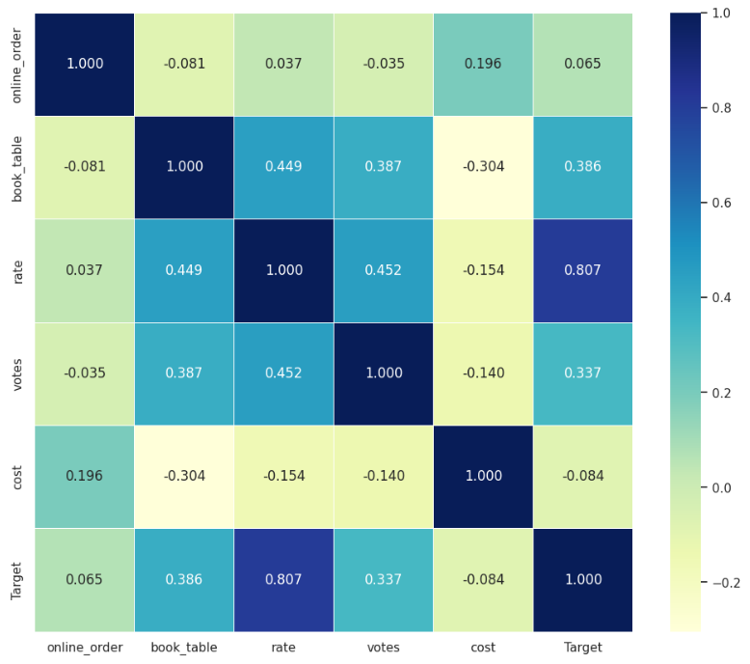
2. Correlation Between Different Variables
It’s a heatmap of the correlation matrix for numerical columns in the DataFrame.
Positive correlations will be represented by shades of green, while negative correlations will be represented by shades of blue. The intensity of the color will indicate the strength of the correlation, with brighter colors indicating stronger correlations.

Slide 7
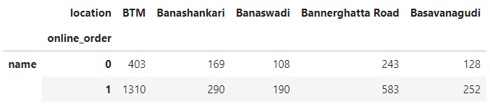
3. Which locations have the highest number of restaurants offering online ordering
It’s a table that display the highst number of restaurants

Slide 8
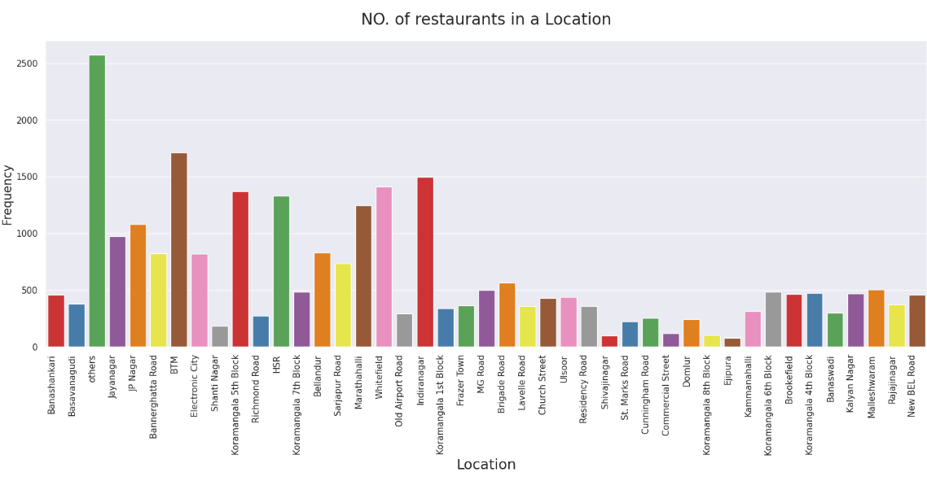
4. What’s The Highst City that have Resturants?
It’s a Bar Chart that display Locations around the world with highst resturants

Slide 9
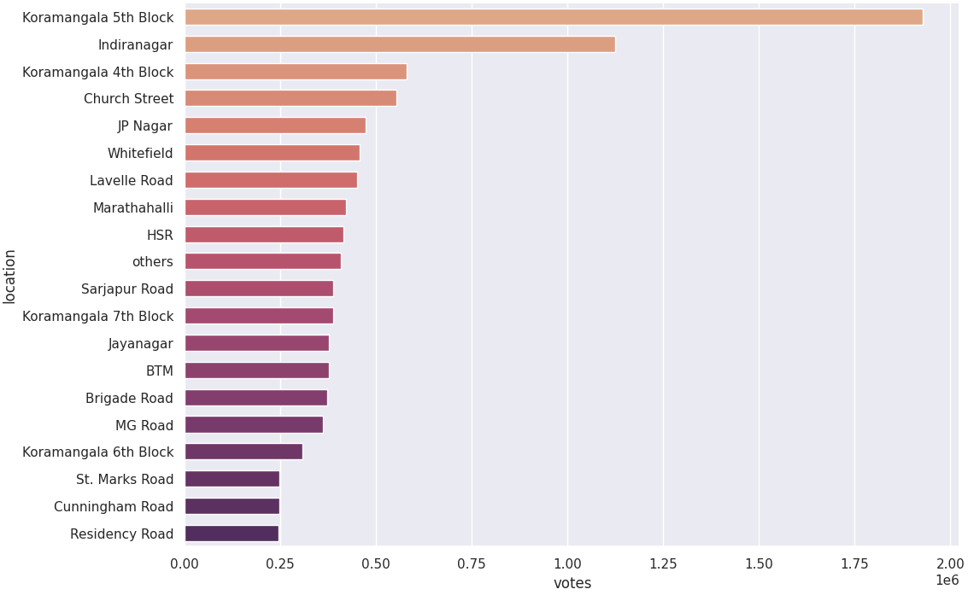
5. Which locations have the highest number of votes for restaurants
bar plot using the seaborn library. It is plotting the top 20 locations by votes on the y-axis and the corresponding number of votes on the x-axis.

Slide 10
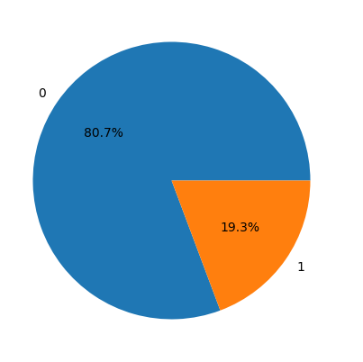
6. What is the distribution of restaurants that offer table booking versus those that do not offer table booking
pie chart to visualize the distribution of the 'book_table' column in the DataFrame

Slide 11
Interpret the evaluation of our machine learning model.
Evaluation of Machine Learning Models:
The evaluate_classifier function splits the data into train and test sets, fits the classifier on the train data, and predicts on both train and test data.
It calculates and prints the accuracy scores for both train and test data, as well as the cross-validation scores.
Additionally, it calculates and prints the precision, recall, and F1-score for the test data, and displays the classification report.
This evaluation process is performed for multiple classifiers, including Logistic Regression, SVM, Gradient Boosting, Random Forest, Decision Tree, and Naive Bayes.

Slide 12
Model Improvement:
The GridSearchCV function is used to perform a grid search to find the best hyperparameters for the Random Forest classifier.
The parameter grid specifies different values for the number of decision trees, maximum depth, minimum samples split, and maximum features.
The best hyperparameters and model are obtained from the grid search results.
The best model is then trained with the best hyperparameters and evaluated on the train and test data.
The train and test accuracy scores are printed, indicating the performance of the improved model.

Slide 13
Results and Conclusion:
The evaluation of the initial models provides insights into their performance, including accuracy scores, cross-validation scores, precision, recall, and F1-score.
The model improvement process demonstrates the effectiveness of grid search in finding optimal hyperparameters for the Random Forest classifier.
The best model, trained with the best hyperparameters, achieves improved accuracy scores compared to the initial models.
Conclude by discussing the importance of model evaluation and improvement in ensuring the model's effectiveness and performance.

Slide 14
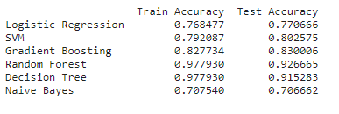
Sample for our results for algorithms

Slide 15
Future Work:
Discuss potential avenues for further improvement, such as exploring other algorithms, feature engineering, or incorporating additional data sources.
Highlight the importance of continuous monitoring and evaluation to ensure the model remains effective as new data becomes available.

Slide 16
Final summary for our results and how you can make use of it in this use case.
Accuracy Scores:
The code evaluates multiple classifiers on the given dataset and calculates the accuracy scores for both the train and test data.
The train accuracy score measures how well the classifier performs on the data it was trained on, while the test accuracy score measures its performance on unseen data.
Cross-Validation Scores:
Cross-validation is performed using the cross_val_score function to evaluate the classifier's performance on different train/test splits of the data.
The code prints the cross-validation scores, which represent the accuracy of the classifier averaged over multiple train/test splits.

Slide 17
Precision, Recall, and F1-Score:
The code calculates the precision, recall, and F1-score for the test data.
Precision measures the proportion of correctly predicted positive instances out of all instances predicted as positive.
Recall measures the proportion of correctly predicted positive instances out of all actual positive instances.
The F1-score is the harmonic mean of precision and recall, providing a balanced measure of the classifier's performance.
Classification Report:
The code prints the classification report for the test data, which includes precision, recall, F1-score, and support for each class.
The classification report provides a detailed breakdown of the classifier's performance for each class, allowing for further analysis and understanding of its strengths and weaknesses.

Slide 18

Thanks For Watching

